Slide 1

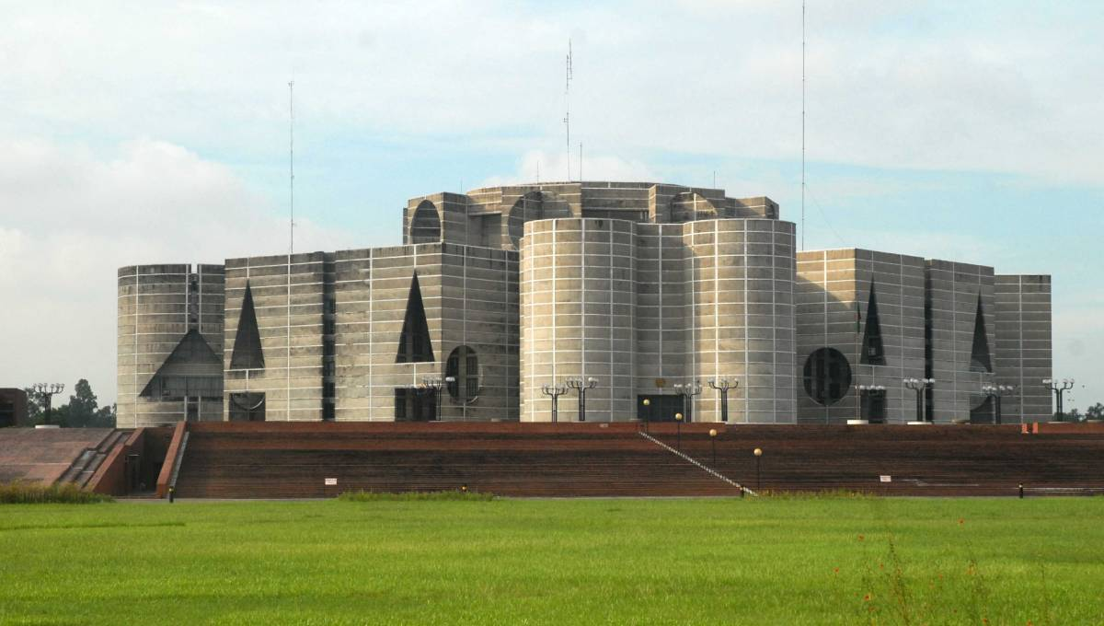
Legal system of Bangladesh
Three branches of a state
(1) Legislative branch (Parliament)

Slide 2
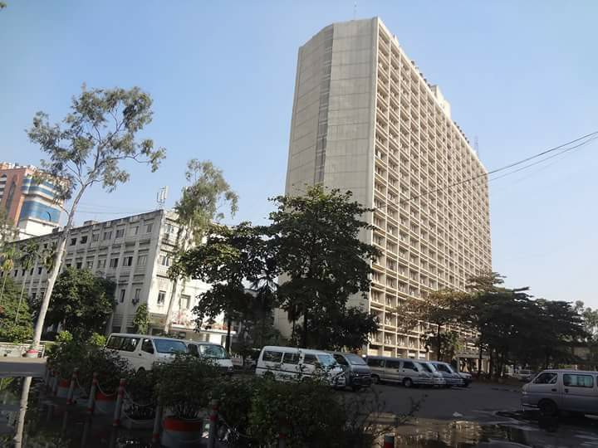
Legal system of Bangladesh
Three branches of a state
(2) Executive Branch

Slide 3
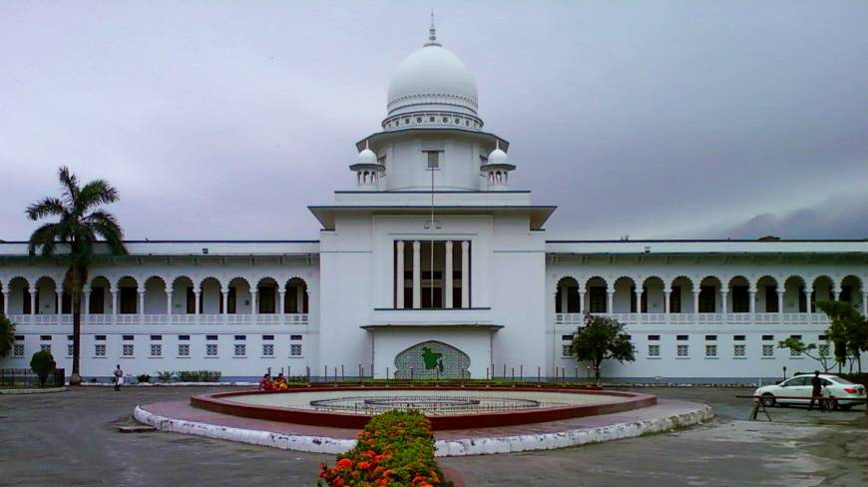
Legal system of Bangladesh
Three branches of a state
(3) Judiciary

Slide 4
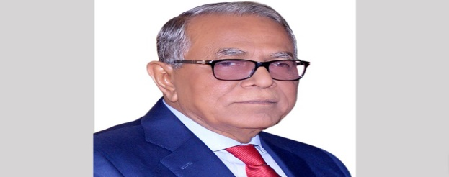
Legal system of Bangladesh
President is the Head of State
Three branches of a state
(1) Members of Legislature
i) Speaker
ii) Members of parliament (300 direct election and 50 reserved seat for women)
Member of Executive
i) Prime Minister
ii) Minister
iii) Deputy Minister
iv) State Minister
v) Secretary…….
vi) Deputy Commissioner,……………..
vii) Police administration

Slide 5
Legal system of Bangladesh
Judiciary
Chief Justice of Bangladesh
Other judges of Supreme Court
Judges of District Courts

Slide 6
Legal system of Bangladesh
Two types of Laws
Constitution is the supreme Law
Made in 1972
Describes powers, functions and relations among them.
Also right of the citizens in the name of fundamental rights.
Other subordinate laws are:
Civil Laws
Criminal laws
Such as Penal Code
Information Communication and Technology Act (ICT) 2006
Digital Security Act, 2009
Copy Right Act
Trade Mark Act

Slide 7
Legal system of Bangladesh
Civil Suits
Declaratory Suit
Cancellation of Deed
Rectification of Instrument
Perpetual Injunction
Partition Suit
Rescission of Contract
Specific Performance of Contract
Recovery of Khas Possession
Eviction of Tennant
Suit for Easement
Money Suit
Pre-emption case
Pre-Emption under Mohammedan Law
Vested Property Release case
Land Survey Tribunals Case
Mandatory Injunction
Misc. Case
Arbitration Suit
Succession Cases
Family Suit:
Dissolution of Marriage
Dower
Maintenance
Guardinship
Restitution of Conjugal Right

Slide 8
Legal system of Bangladesh
Criminal cases
Murder
Culpable homicide
Attempt to commit suicide
Hurt
Kidnapping
Rape
Dacoity
Rioting
Create hatred among classes
Counterfeiting coin
Theft
Extortion
Criminal conspiracy
Criminal tresspass
Defamation (Online publication)
Sedition
Cheating
Forgery
Using false trademark

Slide 9
Legal system of Bangladesh
Judicial System in Bangladesh

Slide 10
Different Stages of a criminal case
Criminal courts in Bangladesh
The Supreme Court of Bangladesh
Appellate Division
High Court Division
District Court
For District Sessions Judge Court Additional Sessions Judge Court Joint Sessions Judge Court Chief Judicial Magistrates Court Additional Chief Judicial Magistrates Court Senior Judicial Magistrates Court Judicial Magistrates Court | For Metropolitan Area Metropolitan Sessions Judge Court Additional Metropolitan Sessions Judge Court Joint Metropolitan Sessions Judge Court Chief Metropolitan Magistrates Court Additional Chief Metropolitan Magistrates Court Metropolitan Magistrates Court

Slide 11
Legal system of Bangladesh
Apart from the regular courts there are some special court and Tribunal
Nari-O-Shisu Nirjaton Tribunal
Speedy Trial Tribunal
International Crimes Tribunal
Cyber Tribunal

